Slide 1
FACIAL EXPRESSION RECOGNITION THROUGH IMAGE PROCESSING AND DEEP CONVOLUTIONAL NEURAL NETWORK(CNN).

Slide 2

Islamic University Kushtia
Presented By:
Md Rakibul Hasan 19114105
Md. Kamrul Hassan 19114117
Most. Ruma Khatun 19114133
S. M. Shofikuzzaman Sumon 19114153
Supervised By:
Mohammad Alamgir Hossain
Assistant Professor,
Department of Computer Science and Engineering.

Slide 3
Outline
>> Abstract
>> Introduction
>> Problem Definition
>> Objective and Motivation
>> System Architecture
>> Dataset
>> Application
>> Project Work
>> Conclusion

Slide 4
Abstract
In today's world, there are number of application techniques used for face recognition, e.g Bio-matrix face recognition, payments system, Access and Security, criminal identification, Advertising, healthcare. The problem with these applications for recognizing facial expressions is still ongoing research. Facial expression detection is based on Image processing and computer vision techniques. In this project, I am presenting the system of an artificially intelligent system that is capable of emotion recognition through facial expressions. This system distinguishes the seven universal emotions: happy, disgust, anger, fear, sad, surprise and neutral. In this, there are different layers used in the neural network after which the best performing network is further optimized and finally returns the emotion of the user.

Slide 5
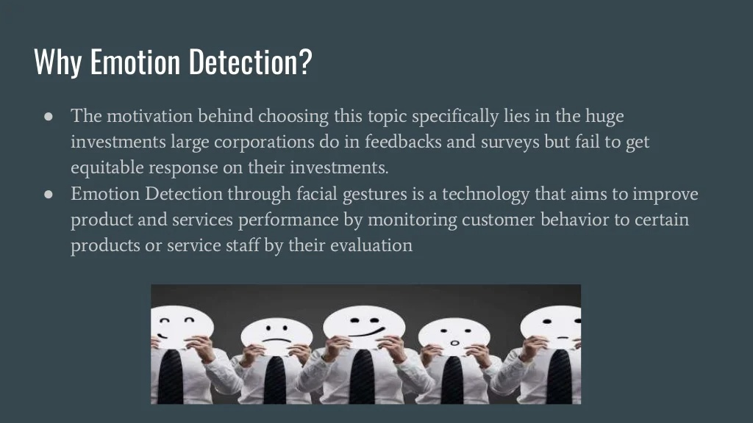

Slide 6
Objective and Motivation
There are several areas where the emotion recognition techniques are used I like digital cameras to automatically take pictures when the user smiles.
However, the most promising applications involve the Humanization of Artificial Intelligent(AI) systems. If computers are able to keep track of the mental state of the user, robots can react to this and behave appropriately. Emotion recognition, therefore, plays a key role in improving human-machine interaction.
Focusing on objective, using neural network-based artificially intelligent Systems capable of deriving the emotion of a person through pictures of his or her face.

Slide 7
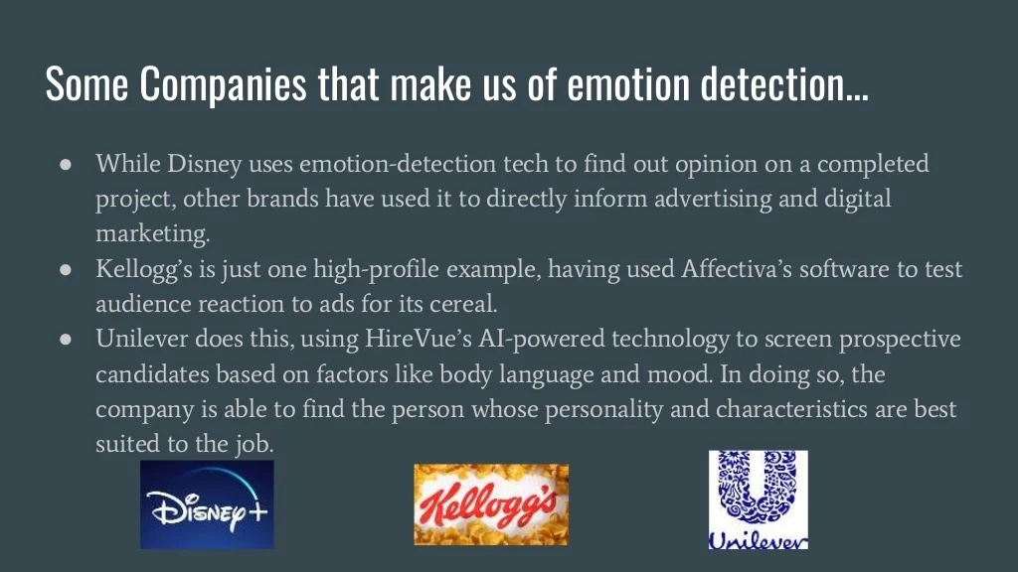
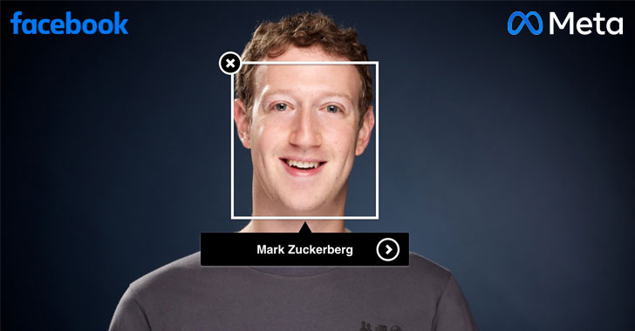
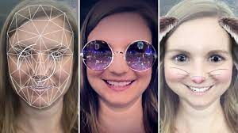
Snapchat

Slide 8
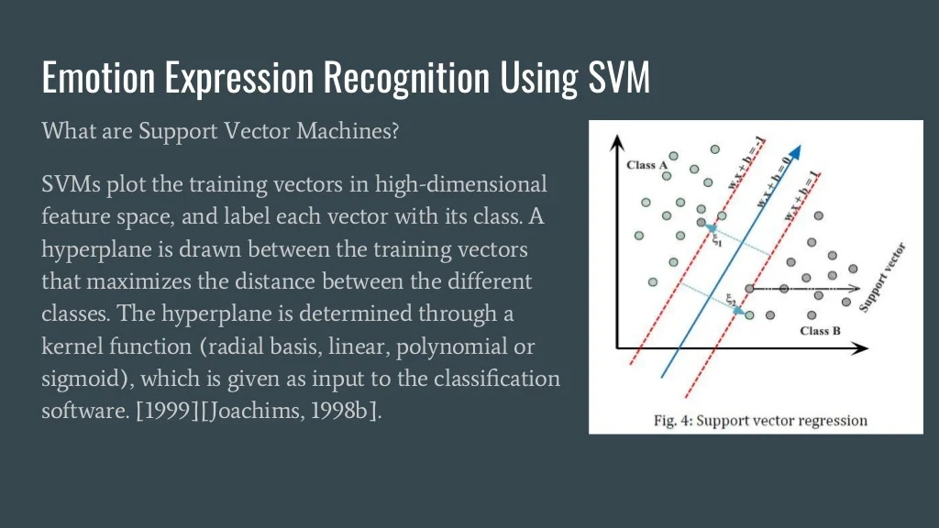

Slide 9
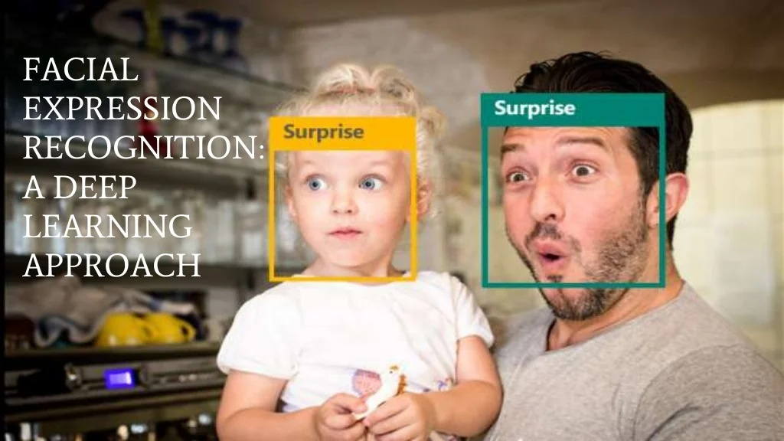
FACIAL EXPRESSION RECOGNITION THROUGH IMAGE PROCESSING AND DEEP CONVOLUTIONAL NEURAL NETWORK(CNN).

Slide 10
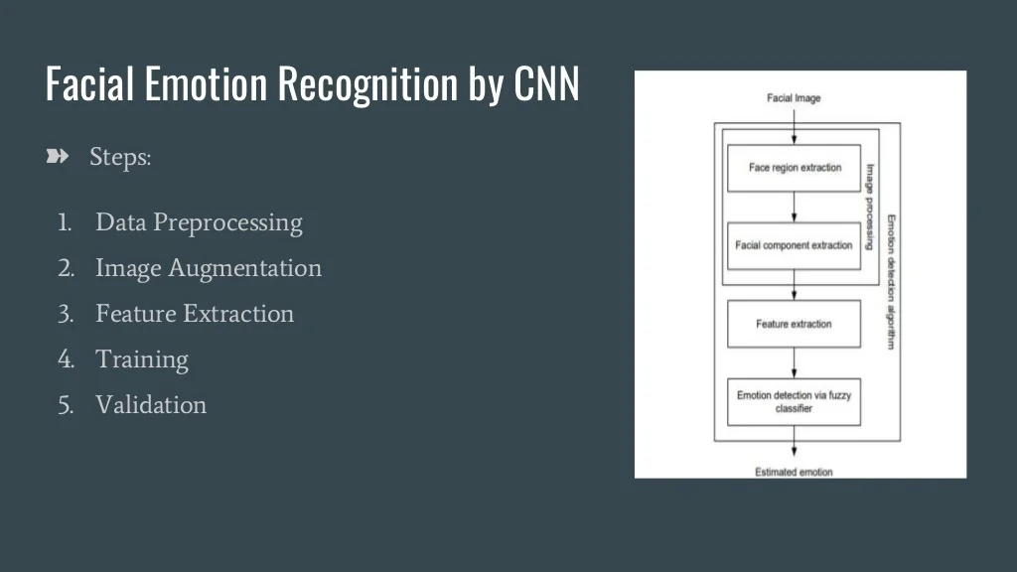

Slide 11
The Dataset
With respect to the tasks to recognize the expression, a dataset required to train and test the network essentially has the following requirements:
Data should be in the form of images in which most of the complete face is visible.
The faces must be mostly front-facing, i.e. the Y and Z axis rotation of faces must not be too high.
The resolution of images must be sufficiently large.
FERC-2013 Dataset:
The Facial Expression Recognition Challenge was an open-for-all challenge as part of the ICML 2013 conference workshop, which contained an emotion-annotated dataset of cropped images of faces.

Slide 12
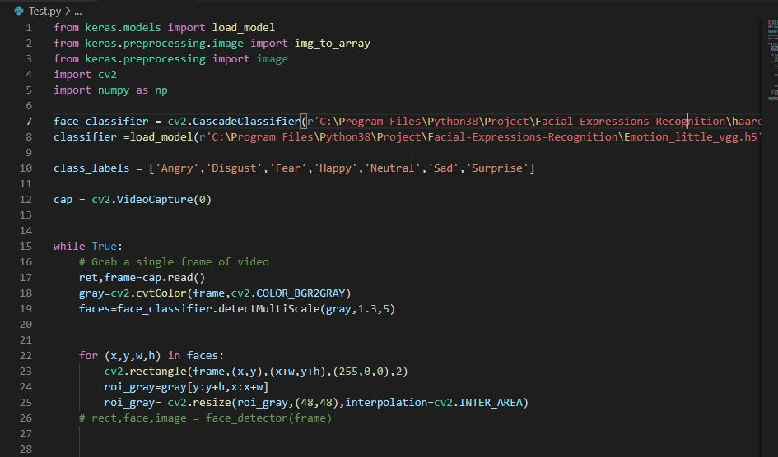
Test part code

Slide 13
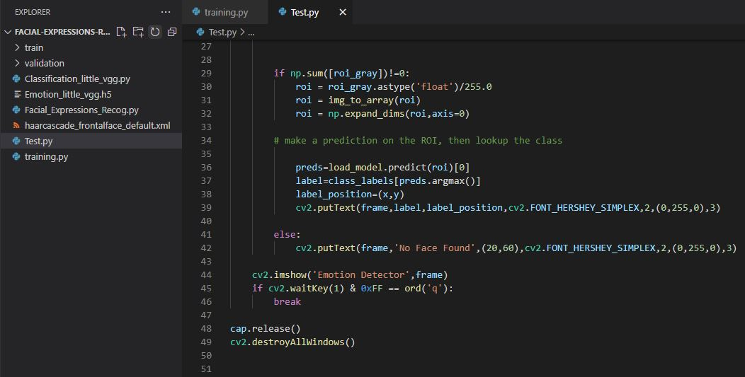
Cont..

Slide 14
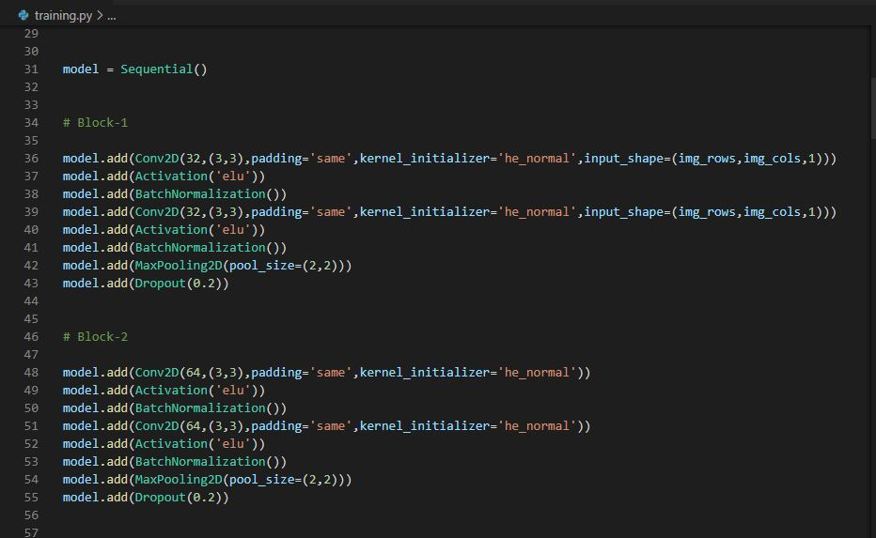
Training Code

Slide 15
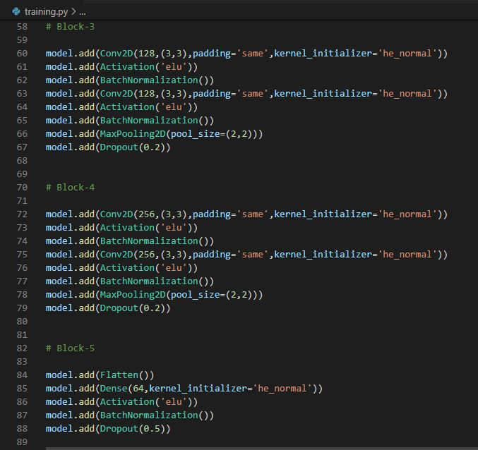
Cont..

Slide 16
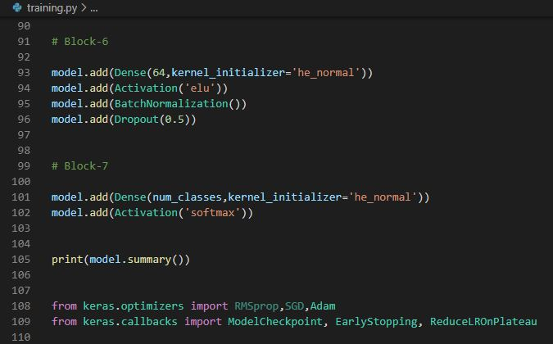
Cont..

Slide 17
Application
Following are rapidly growing areas where the system can be used:
Cameras or Cell phone camera applications.
For the Advertising.
Content creators to sell products e.g. Affectiva company.
Q-Sensor- to guise emotion of children.
Learner emotion detection.
Attitude and Action detection.
Marketing and scientific research- Visage SDK.
Face analytics and emotion recognition - Eyries.
Film industries.

Slide 18
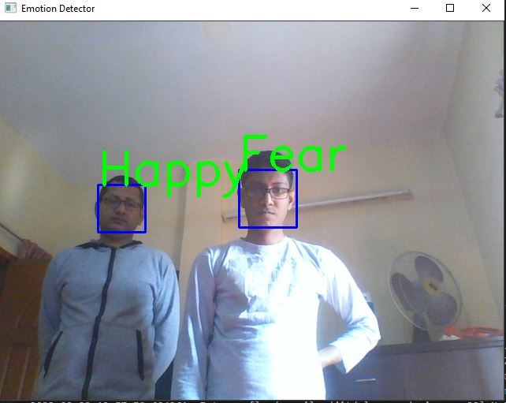
Output Image Screenshot

Slide 19
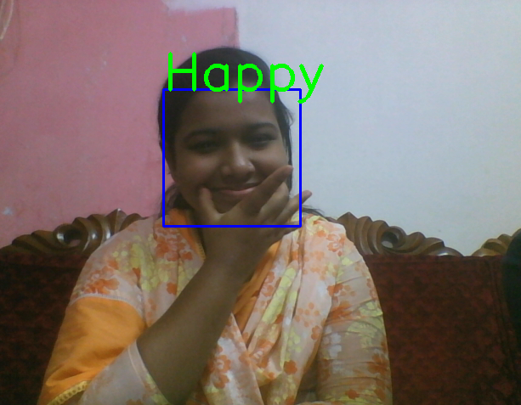
Cont..

Slide 20
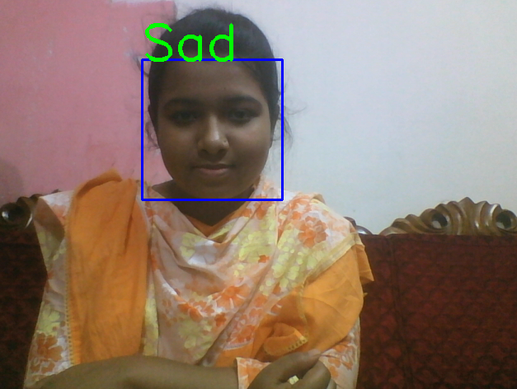
Cont..

Slide 21
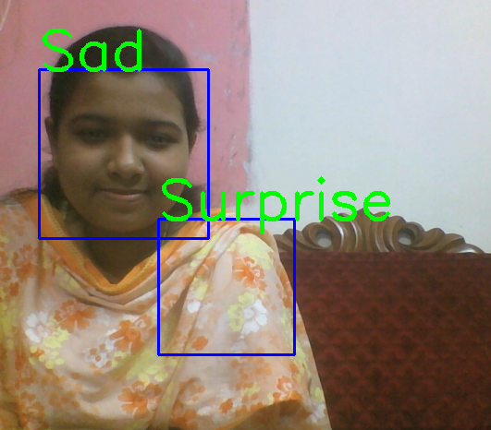
Cont..

Slide 22
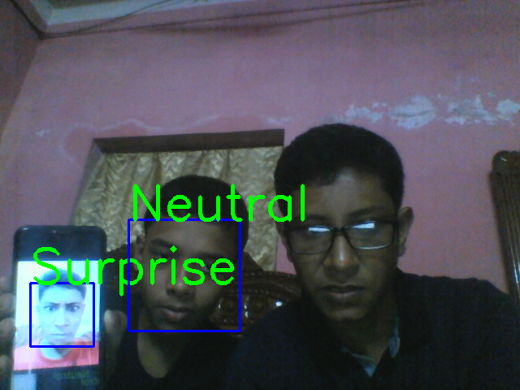
Cont..

Slide 23
Conclusion
In this project, I studied the what are the techniques used previously, what are the real-time application for the proposed system which covered in objective and motivation.
By using the mentioned dataset the neural network will be trained and by adding maximum hidden layer i.e. with the deep layer in the convolutional network the result will be calculated. It covers the concept of facial expression recognition with aimed to classify images of faces into any of seven discrete emotion or face expression categories that represent universal human emotions.

Slide 24

Any Question

Slide 25
Thank You!

